Slide 1
ALGORITHM DESIGN
AND ANALYSIS
PROJECT 2: Dijkstra’s Algorithm
Wong Chu Feng & Rivaldo Billy Sebastian

Slide 2
(a) Implementation 1
G = (V, E) is stored in an adjacency matrix, priority queue pq is stored in an unordered array.
def minWeight(w, SS,vertices):
min=sys.maxsize
for i in range(vertices):
if (SS[i]==False and w[i]<=min):
min=w[i]
min_index = i
return min_index

Slide 3
(a) Implementation 1
def dijkstraMatrix(g, src, vertices):
start = timer()
d=[sys.maxsize]*vertices
S=[False]*vertices
pq = []
pq.append(src)
d[src]=0
while (pq):
u = minWeight(d,S,vertices) # return index of smallest node
pq.remove(u)
S[u]=True
for j in range(vertices):
if (S[j]==False and g1[u][j] and d[u]+g1[u][j]<d[j]):
if j not in pq:
pq.append(j)
d[j] = d[u]+g1[u][j]
return timer()-start
G = (V, E) is stored in an adjacency matrix, priority queue pq is stored in an unordered array.

Slide 4
(a) Implementation 1: Time Complexity
G = (V, E) is stored in an adjacency matrix, priority queue pq is stored in an unordered array.
Adding all |V| vertices to pq takes O(|V|) time.
Iterating |V| times takes O(|V|) time. In each loop:
Removing the node with minimal dist takes O(|V|) time.
Recalculate dist[u] and update pq takes O(1) time.
Thus, total time complexity is O(|V|) + O(|V|) . O(|V|) = O(|V|²).

Slide 5
(b) Implementation 2
def dijkstraList(g, src, vertices):
start = timer()
d=[sys.maxsize]*vertices
pq=[]
d[src]=0
for v in list:
heapq.heappush(pq, (v, d[v]))
heapq.heapify(pq)
while (len(pq)):
curr, currW = heapq.heappop(pq)
for neighbour in range(len(list[curr])):
weight=list[curr][neighbour]
dist = currW+weight
if dist<d[neighbour]:
d[neighbour]=dist
heapq.heappush(pq, (neighbour, dist))
heapq.heapify(pq)
return timer()-start
G = (V, E) is stored in an adjacency list, priority queue pq is stored in a minimizing heap.

Slide 6
(b) Implementation 2: Time Complexity
G = (V, E) is stored in an adjacency list, priority queue pq is stored in a minimizing heap.
Constructing priority queue pq of |V| vertices takes O(|V|) time.
Iterating over all vertices’ neighbours and updating their dist values takes O(|E|) time.
Each iteration of the loop takes O(|V|) time.
Minimizing heap data structure allows to removing the node u with minimal dist and recalculate dist[u] in O(log|V|) time.
Thus, total time complexity is O(|V|) + O(|E| . log(|V|)) + O(|V| . log(|V|)) = O(|E| . log(|V|)).

Slide 7
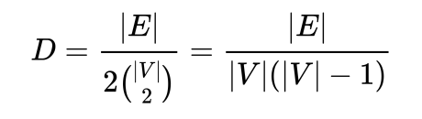

(c) Time Complexity Analysis
Graph density D for simple directed graphs:
=> |E| = D ( |V|² - |V| )

Slide 8


(c) Time Complexity Analysis
If the input graph is
Dense: time complexity in AdjList() follows
O( D*|V|². log(|V|) ) > O(|V|²)
Better to use AdjMatrix() in this case.
Sparse: time complexity in AdjList() follows
O(D*|V|² . log(|V|)) < O(|V|²)
Better to choose AdjList() in this case.

Slide 9
(c) Empirical Analysis
Generating Graph G = (V, E).
def generateMatrix(vertices, prob):
# p affects graph density
g = nx.erdos_renyi_graph(vertices,prob,seed=False)
for (u,v) in g.edges():
g.edges[u,v]['weight'] = random.randint(1,50) #adding value of weights
return g

Slide 10
(c) Empirical Analysis
Representing graph in Adjacency Matrix and Array of Adjacency List.
def convert_to_matrix(graph, vertices):
M = scp.csr_matrix.toarray(nx.adjacency_matrix(graph))
return M
def convert_to_list(graph, vertices):
tmp = scp.csr_matrix.toarray(nx.adjacency_matrix(graph))
L = defaultdict(list)
for i in range(vertices):
for j in range(vertices):
if tmp[i][j]!=0:
L[i].append(j)
return L

Slide 11
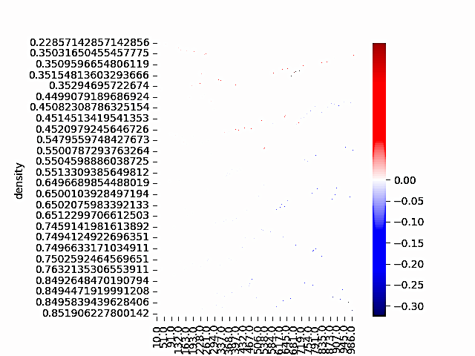
(c) Empirical Analysis
Comparing graphDensity with running time

Slide 12


Further Analysis
Dense graphs: adjMatrix is preferred
for each vertex: no. of other vertices to visit is close to |V|
Sparse graphs: adjList is preferred
for each vertex: no. of other vertices to visit = D * |V|
where D*|V| ⩽ |V| ∵ D ⩽ 1

Slide 13
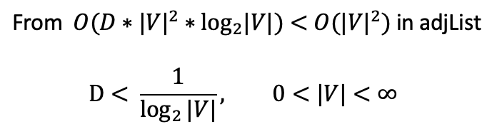

adjMatrix VS adjList
When |V| is large, matrix < list when considering SPACE complexity
Time complexity:
Real world graphs have densities
eg. maps, IP routing, etc: adjList
Application: frequency of addition and deletion of vertices

Slide 14
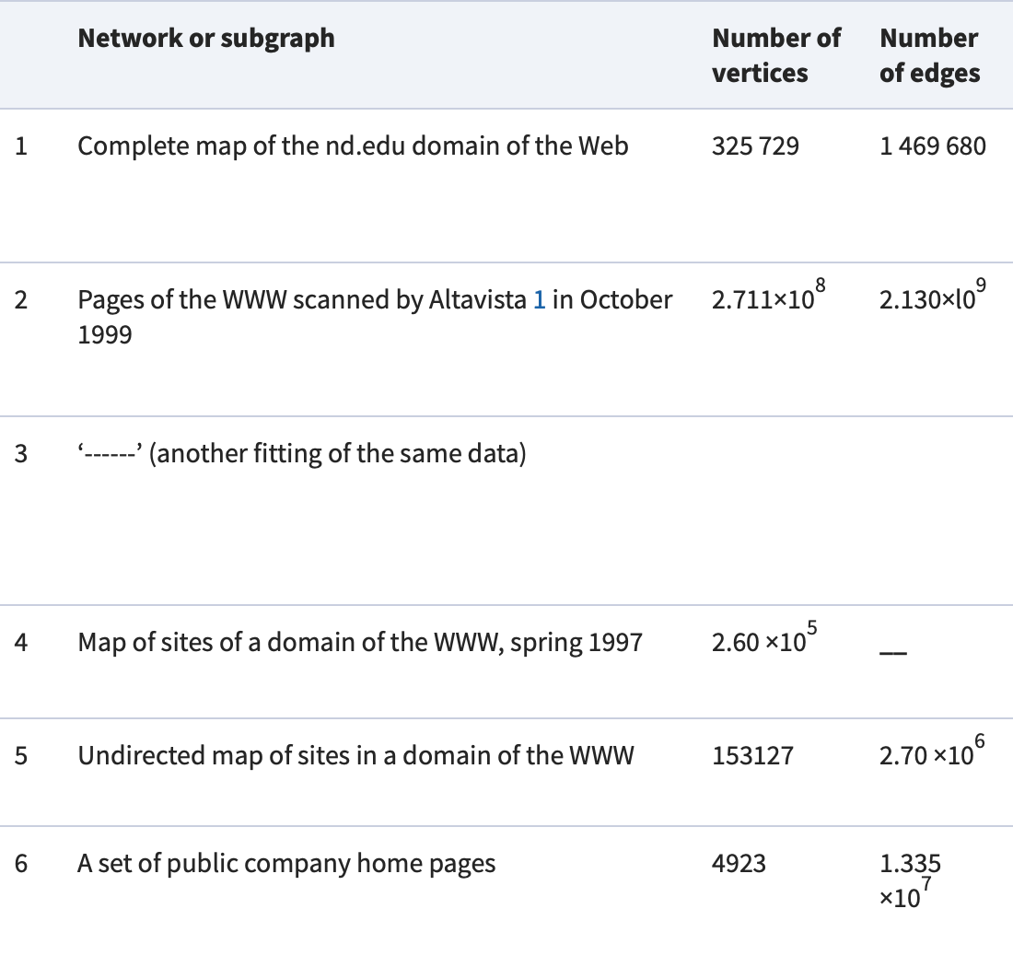
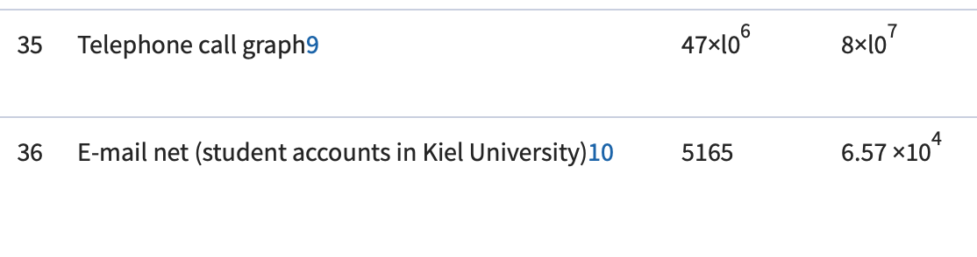
Evolution of Networks: From Biological Nets to the Internet and WWW (Dorogovtsev et al., 2010)

Slide 15
Reflection
+ Took average of each calculation of running time that was repeated 3 times
- Erdos-Renyi graph was generated (varying p is insufficient)
Each edge is generated randomly => similar vertex degree
Instead, edges are probabilistically more likely to connect to vertices with hire degrees in world graphs (Barabasi et.al., 1999)

Slide 16
Emergence of Scaling in Random Networks (Barabasi et al., 1999)
“ A newly created Web page will be more likely to include links to well-known popular documents with already high connectivity “
→ probability of Edge formation is not uniform

Slide 17
Some Notes
Libraries Used:
from matplotlib import colors
import matplotlib.pyplot as plt
import seaborn as sns
import sys
import heapq
import random
import numpy as np
import pandas as pd
import networkx as nx
from collections import defaultdict
from scipy import sparse as scp
from scipy import stats
from timeit import default_timer as timer

Slide 18
Thank You!

